Slide 1
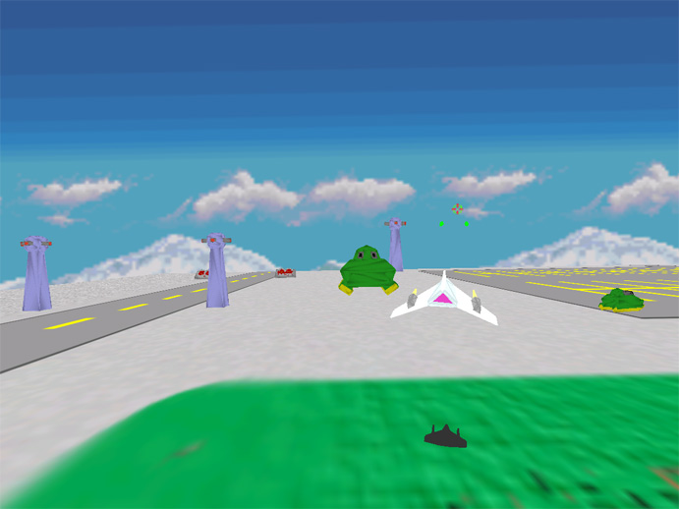
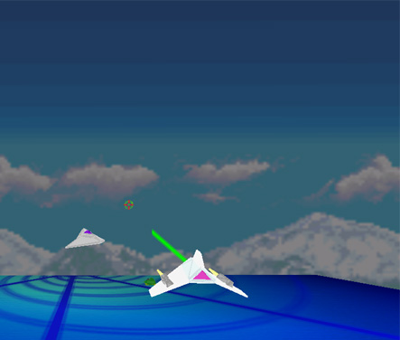
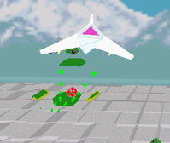
3D Flight Sim (Starfox Replica)
Model Creation
Scene Layout
Transformations
Camera Setup
Collision Detection
Fog
Ship Movement
Ship Shadows
Projectiles
Enemy Paths
FR Independent
Audio
Texture mapping
Explosions and Gravity
Donald Santos
Matthew Greer
Casey Kretschman

